Slide 1

SOFTWARE QUALITY ENGINEERING
BS Software Engineering
Semester, Fall 2025
Credit Hours 2-1
Instructor: Naseer Jan
Department of Creative Technologies
Air University
Islamabad, Pakistan

Slide 2
Agenda
Previous Week Review
Subtopics

Slide 3
Software Quality Standards
Software quality standards are the unsung heroes in this story, providing a set of guidelines, criteria, and best practices that ensure any software product or process meets specified quality requirements and objectives.
Imagine them as the rulebook for a game, where the game is the complex process of creating software. They offer a framework that allows organizations to assess, measure, and improve the quality of their software development practices and deliverables. From functionality, reliability, and usability to efficiency, maintainability, and portability — these standards cover it all.
Their importance can’t be overstated, as they lay the foundation for high-quality, reliable, and secure software products and services.
First on our list is ISO/IEC 25000, also known as SQuaRE. This international standard is a beacon for software quality. It’s broken down into two main parts.
ISO/IEC 25010 outlines a set of quality characteristics and sub-characteristics such as functionality, reliability, and usability — all factors that can be used to evaluate the quality of a software product.
ISO/IEC 25040 provides guidance on quality requirements and evaluation processes for software products and systems. It’s like a roadmap guiding developers and organizations on how to ensure their software meets certain quality benchmarks.

Slide 4
Software Quality Standards
Overall, ISO/IEC 25000 is a comprehensive tool that helps organizations measure and improve the quality of their software. It sets the stage for understanding what quality means in the realm of software and how it can be achieved.
Next, we delve into ISO/IEC 9126 and IEEE standards.

Slide 5
Software Quality Standards
ISO/IEC 9126 is a well-recognized standard that offers a comprehensive software quality model. It’s divided into two parts:
ISO/IEC 9126-1 defines six fundamental characteristics of software quality: functionality, reliability, usability, efficiency, maintainability, and portability. Each characteristic is further broken down into sub-characteristics to provide a detailed view of software quality. For instance, functionality includes suitability, accuracy, interoperability, security, and functionality compliance. Reliability includes maturity, fault tolerance, recoverability, and reliability compliance.
ISO/IEC 9126-2 provides metrics and evaluation methods for these quality attributes — defining not only what quality looks like but also how to measure and assess it.

Slide 6
Software Quality Standards
Now, let’s switch gears and talk about IEEE standards, specifically IEEE 730, IEEE 1061, and IEEE 1633.
The IEEE (Institute of Electrical and Electronics Engineers) plays a major role in software quality standards:
IEEE 730 provides guidelines for software quality assurance plans, outlining processes and procedures that ensure software quality throughout its development life cycle.
IEEE 1061 focuses on software quality metrics and methodologies, providing standards for developing and validating software quality metrics — crucial for measuring and improving quality.
IEEE 1633 addresses software reliability engineering, providing techniques for managing, predicting, and measuring software reliability.
Together, ISO/IEC 9126 and the IEEE standards offer a holistic approach to software quality — from defining and measuring attributes to planning assurance and managing reliability.

Slide 7
Software Quality Standards
Now let’s turn to CMMI, and ANSI/IEEE 1012.
Our journey begins with CMMI (Capability Maturity Model Integration), which has two key components:
CMMI for Development — a framework for enhancing software development and engineering processes, helping organizations ensure consistency, predictability, and effectiveness.
CMMI for Services — designed for service-oriented organizations, focusing on improving IT services and software maintenance to ensure customer satisfaction and operational efficiency.

Slide 8
Software Quality Standards
Then there’s ANSI/IEEE 1012, which defines the criteria for software verification and validation processes.
Verification ensures a product meets specified requirements at each stage of development.
Validation ensures the final system satisfies those requirements.
This standard ensures software products are thoroughly tested and validated, fostering confidence in their reliability and performance.

Slide 9
Software Quality Standards
Lastly, we have SEI, OWASP, and ISO/IEC 27001.
The Software Engineering Institute (SEI) developed the Software Engineering Body of Knowledge (SWEBOK) — a comprehensive overview of software engineering principles, practices, and knowledge areas. It covers topics from requirements and design to testing, maintenance, and professional practice, serving as a foundational reference for software engineers.
OWASP (Open Web Application Security Project) is an international organization dedicated to improving software security. Its OWASP Top 10 is a regularly updated list of the most critical security risks to web applications — helping developers and organizations prioritize security measures and best practices.
ISO/IEC 27001 specifies the requirements for establishing, implementing, maintaining, and continually improving an information security management system. It’s about creating robust systems and processes to protect data effectively and respond to security incidents efficiently.
In essence, these standards underscore the importance of a holistic approach to software quality. SEI’s SWEBOK provides foundational knowledge, OWASP highlights critical security risks, and ISO/IEC 27001 ensures comprehensive information security management.

Slide 10
Software Quality Standards
So, what have we learned about software quality standards?
We’ve explored numerous standards that serve as guiding lights in software quality — from ISO/IEC 25000 (quality characteristics and evaluation) to ISO/IEC 9126 (metrics and assessment), and from IEEE 730 (quality assurance plans) to CMMI and ITIL (process improvement). We’ve also looked at ANSI/IEEE 1012 (verification and validation), Agile and Lean (continuous improvement), and SEI, OWASP, and ISO/IEC 27001 (security and knowledge frameworks).
Adhering to these standards leads to robust quality management systems, improved processes, and reliable, secure, high-quality software products and services.

Slide 11
Software Quality Standards
Software quality standards are established guidelines, frameworks, or benchmarks that define criteria and best practices for ensuring the quality of software products and processes. These standards help organizations improve the quality, reliability, maintainability, and security of their software, thereby enhancing customer satisfaction and reducing risks. Here are some prominent software quality standards:
ISO/IEC 25000 (SQuaRE): The ISO/IEC 25000 series, also known as the Software Product Quality Requirements and Evaluation (SQuaRE) standard, provides a comprehensive framework for evaluating and specifying software product quality. It includes standards such as ISO/IEC 25010 (Quality Model) and ISO/IEC 25040 (Evaluation Process).
ISO/IEC 9126: The ISO/IEC 9126 standard defines a model for software quality characteristics and provides guidelines for measuring and evaluating software quality attributes such as functionality, reliability, usability, efficiency, maintainability, and portability.

Slide 12
Software Quality Standards
IEEE 730: The IEEE 730 standard outlines the requirements for software quality assurance plans, including the scope, objectives, responsibilities, procedures, and resources needed for ensuring software quality throughout the development lifecycle.
CMMI (Capability Maturity Model Integration): CMMI is a process improvement model that provides a set of best practices for enhancing the maturity and capability of software development processes. It includes levels of maturity and capability for organizations to assess and improve their software development practices.
ISO/IEC 12207: The ISO/IEC 12207 standard defines a framework for software life cycle processes, including processes related to software development, maintenance, and support. It provides guidelines for managing and executing software development projects effectively.

Slide 13
Software Quality Standards
ISO 9001: While not specific to software, ISO 9001 is a quality management standard that can be applied to software development organizations. It focuses on establishing and maintaining quality management systems that meet customer requirements and enhance customer satisfaction.
IEC 62304: Specifically for medical device software, the IEC 62304 standard provides requirements for the software life cycle processes of medical device software, including software development, maintenance, and risk management.
OWASP Top 10: The Open Web Application Security Project (OWASP) Top 10 is a list of the most critical security risks facing web applications. It provides guidelines for developers to address common security vulnerabilities in software applications. Adhering to these software quality standards can help organizations establish robust quality assurance processes, improve software development practices, mitigate risks, and deliver high-quality software products that meet or exceed customer expectations.

Slide 14
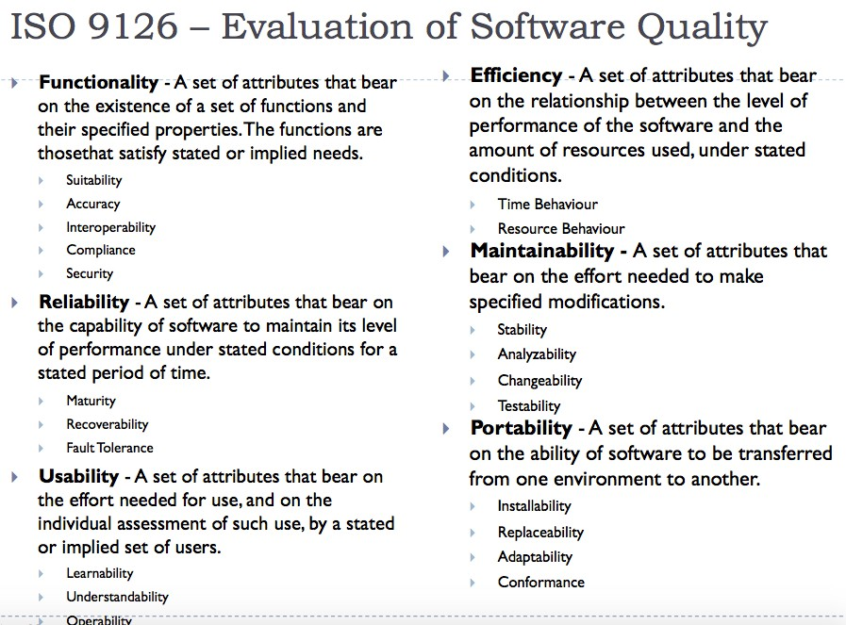
Software Quality Standards

Slide 15
Software Quality Standards

Slide 16
Questions
Questions and Answers sessions

Slide 17


